Slide 1

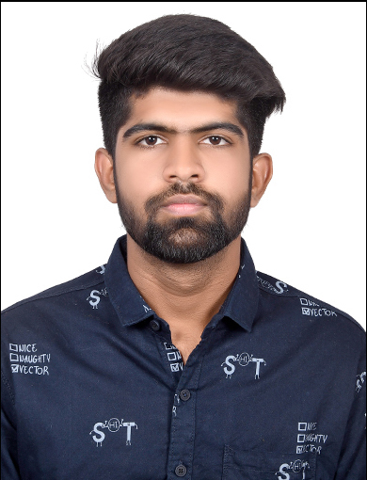
STUDENT DETAILS
Name:- BHOJWANI DEEPAK RAJESHKUMAR
SkillsBuild Email ID:- deepakbhojwani07d@gmail.com
SkillsBuild Organization:- DGT
Collage Name:- L.D. College of Engineering
Collage State:- Gujarat
Internship Domain:- Fronted Development
Internship Starting Date:- 12/06/2023
Internship End Date:- 24/07/2023

Slide 2


PROJECT TITLE/PROBLEM STATEMENT
E-Commerce Shopping Website Replica:
(Cara Shopping Clone Website)

Slide 3
AGENDA
Create a user-friendly Cara Clone Website with features like Product Catalog, Shopping Cart, About Page, Contact Page, Blog Page and Order Management.

Slide 4
PROJECT OVERVIEW
The Cara Shopping Clone Website Project is my real online shopping project which aims to the core functionalities of including User Registration, Product Catalog, Shopping Cart, About Page, Contact Page, Blog Page And Order Management, And Personalized Recommendations, Providing Users With Other Similar Shopping Experience.

Slide 5

WHO ARE THE END USERS OF THIS PROJECT?
The end users of the Cara Shopping Clone Website are individuals who want to purchase a wide range of products conveniently and securely, offering them a seamless online shopping experience similar to the original Amazon platform. These users can browse, search, add items to their cart, make purchases, track orders, and access personalized recommendations.

Slide 6

YOUR SOLUTION AND ITS VALUE PROPOSITION
The Cara Shopping Clone Website solution addresses the needs online shoppers by offering a familiar, convention, and secure platform. By replicating some amazon’s & other shopping websites key features, providing personalized, recommendations and ensuring reliabal transactions, the solution brings value to users in term of convenience, trust, information and an enhance shopping experience.

Slide 7


HOW DID YOU CUSTOMIZE THE PROJECT AND MAKE IT YOUR OWN
The unique aspects and innovative features distinguish the Cara Shopping Clone Website from the existing platform, adding creativity, interactivity and personalization to the user experience. By integrating customization, social integration, AR shopping, gamification element, and AI-driven recommendations the clone website offers users a remarkable and cutting-edge shopping platform.

Slide 8
MODELLING
The modeling of the Cara Shopping Clone Website involves creating a user-centric platform with a robust product catalog, intuitive shopping cart functionality, secure payment gateway integration, and efficient order management system. Additionally, personalized recommendations and user reviews are incorporated to enhance the overall shopping experience and drive customer engagement.

Slide 9
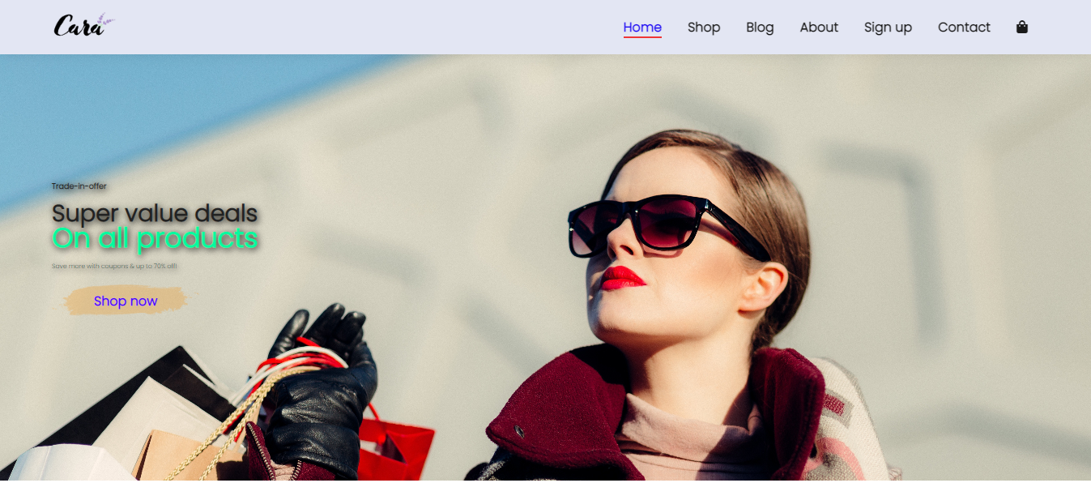
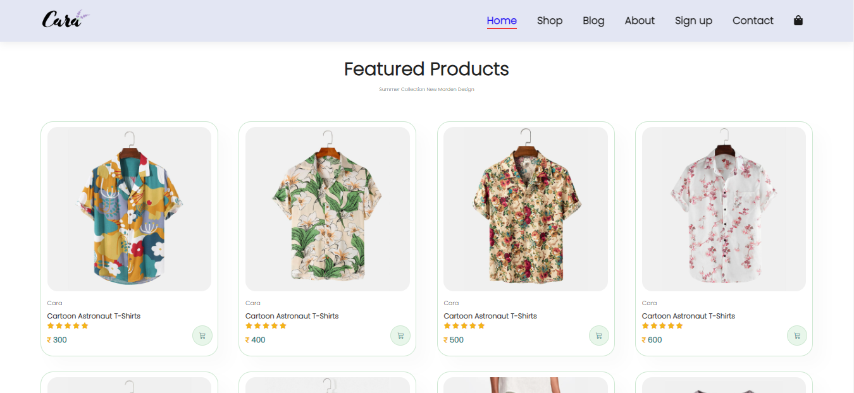
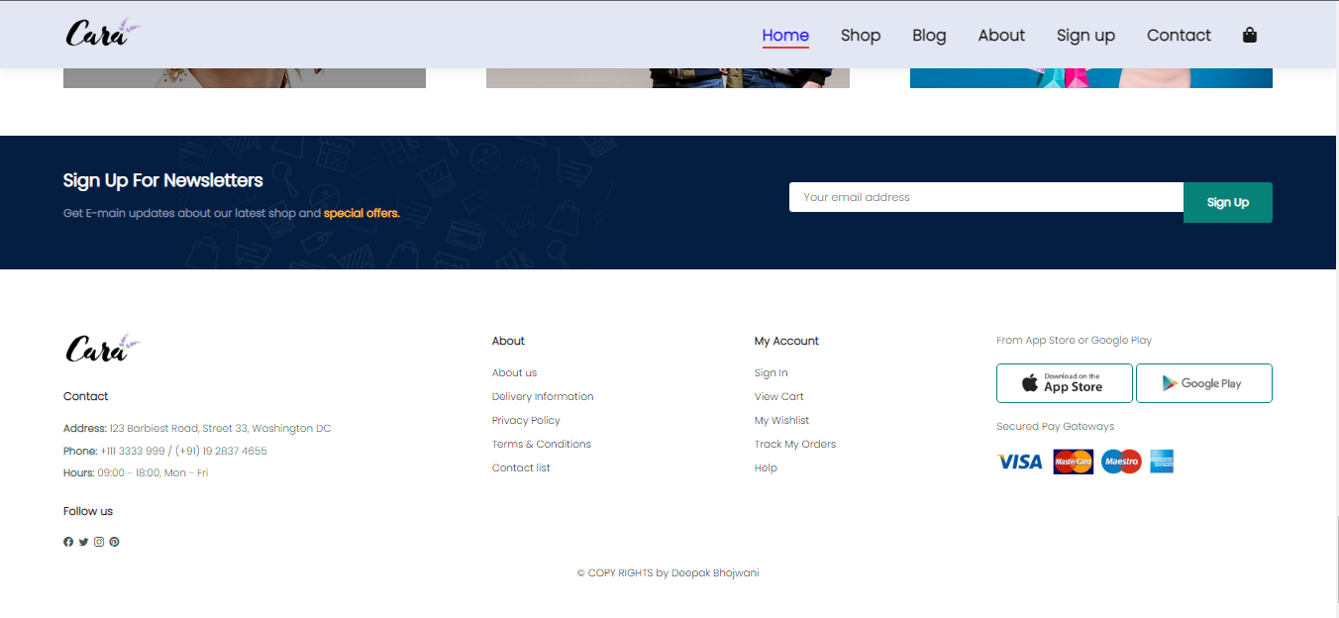
RESULTS
The result of an Cara Shopping Clone Website is a fully functional e-commerce platform that mimics the core features and functionalities of the Websites like Amazon, Flipkart, Mynta Etc... Users can browse and purchase products, manage their orders, leave reviews, and receive personalized recommendations, providing a familiar and engaging shopping experience similar to Amazon, Flipkart, Myntra.

Slide 10

LINKS
Deployed on Github:
https://deepak-bhojwani.github.io/Cara-Shopping-Clone-Website/
My Profile on Github:
https://github.com/Deepak-Bhojwani
My Portfolio Website:
https://deepak-bhojwani.github.io/
THANK YOU

